Slide 1
Physiological signal introduction and processing
Dr Zhiqiang Zhang
School of Electronic and Electrical Engineering
School of Mechanical Engineering
Faculty of Engineering and Physical Sciences
Email: z.zhang3@leeds.ac.uk
Room: EEE 1.69

Slide 2
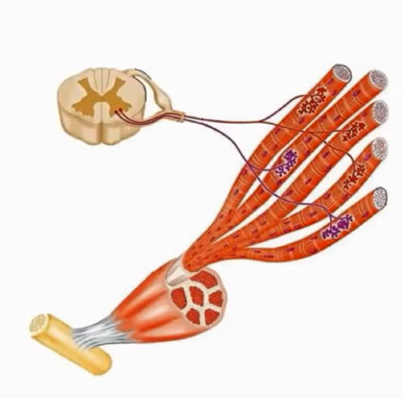
Functional Characteristics
Contractility
Extensibility
Excitability
Notes:
Ability to receive and respond to a stimuli

Slide 3
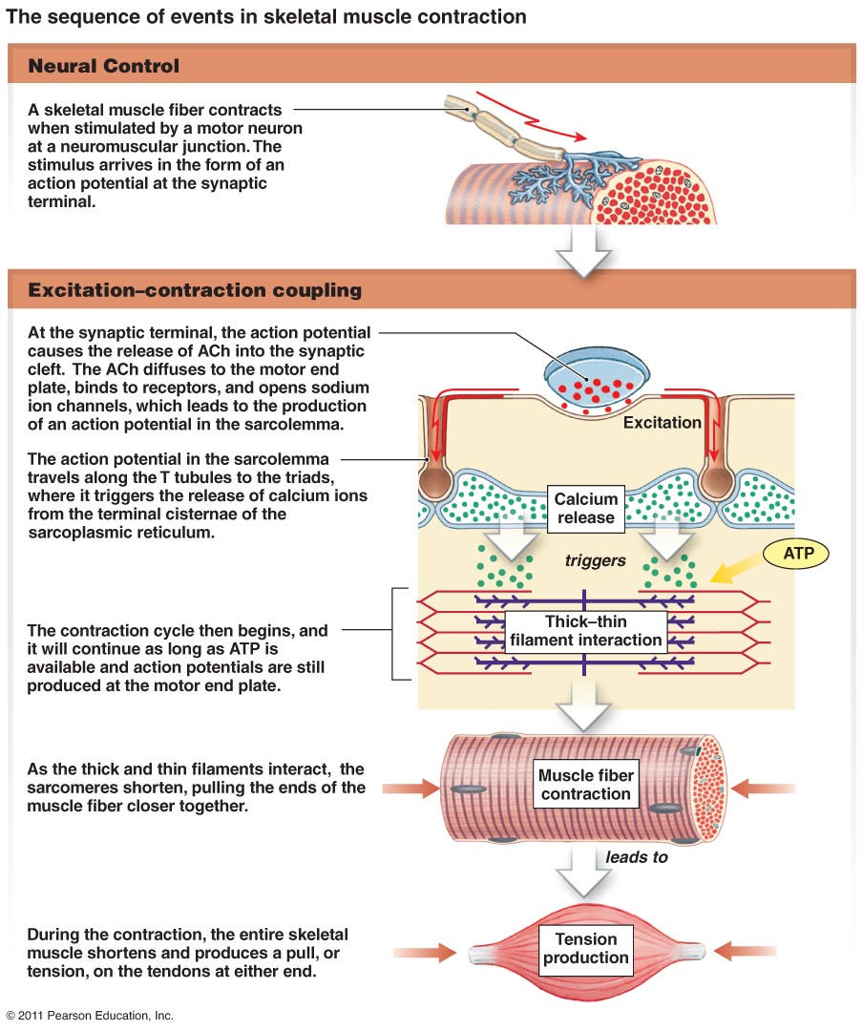
Sequence in skeletal muscle contraction

Slide 4
EMG basic
Motor unit
The smallest functional unit to describe the neural control of the muscular contraction process
The motor neuron, situated in the spinal cord, has a long axon which goes to the muscle.
Each axon splits up into a number of branches each of which ends on a motor endplate on a muscle fibre.
Ensemble of a motor neuron and the muscle fibres it innervates is called the motor unit.

Slide 5
EMG basic
Motor Unit Action Potential
Typically, each motor-neuron innervates several hundred muscle fibers (innervation ratio)
Motor Unit Action Potential (MUAP) = summed electrical activity of all muscle fibers activated within the motor unit
Muscle force increased through higher recruitment and increased rate coding

Slide 7
Types of EMG electrodes
Inserted
Fine-wire (Intra Musular)
Needle
Implanted
Surface
Extramuscular

Slide 8
Fine-wire/Needle Electrodes
Advantages
Extremely sensitive
Record the activity of a single motor unit
Access to deep musculature
Little cross-talk concern
Disadvantages
Requires medical personnel, certification
Repositioning nearly impossible
Detection area may not be representative of entire muscle

Slide 9
Surface Electrodes
Advantages
Quick, easy to apply
No medical supervision, nor required certification
Minimal discomfort
Easy to reposition
Disposable
Disadvantages
Generally used only for superficial muscles
Cross-talk concerns
No standard electrode placement
May affect movement patterns of subject
The most common and widely used in practice

Slide 10
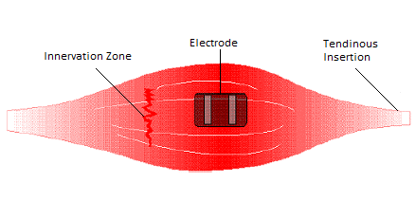
Surface electrode placement
The surface EMG electrodes should be placed
between the motor unit and the tendinous insertion of the muscle,
along the longitudinal midline of the muscle
Electrode alignment with the direction of muscle fibres to increase probability of detecting same signal

Slide 11
When the electrodes are arranged in this way, the detecting surfaces intersect most of the same muscle fibres, and as a result, an improved superimposed signal is observed.

Slide 12
Factors influencing the EMG signal
The quality of the detected sEMG signal determines the usefulness of the information extracted from the sEMG signal.
It is of high importance to maximise the quality of the acquired signal.
The quality of the acquired signal depends on:
Sensor location (upon the middle of muscle belly)
Notes:
The human body is a good electrical conductor, but unfortunately the electrical conductivity varies with tissue type, thickness (Fig. 14), physiological changes and temperature

Slide 13
Factors influencing the EMG signal
The quality of the detected sEMG signal determines the usefulness of the information extracted from the sEMG signal.
It is of high importance to maximise the quality of the acquired signal.
The quality of the acquired signal depends on:
Sensor location (upon the middle of muscle belly)
Tissue characteristics
Notes:
The human body is a good electrical conductor, but unfortunately the electrical conductivity varies with tissue type, thickness (Fig. 14), physiological changes and temperature

Slide 14
Notes:
The human body is a good electrical conductor, but unfortunately the electrical conductivity varies with tissue type, thickness (Fig. 14), physiological changes and temperature

Slide 15
Factors influencing the EMG signal
The quality of the detected sEMG signal determines the usefulness of the information extracted from the sEMG signal.
It is of high importance to maximise the quality of the acquired signal.
The quality of the acquired signal depends on:
Sensor location (upon the middle of muscle belly)
Tissue characteristics
Cross-talk from other muscles
Notes:
The human body is a good electrical conductor, but unfortunately the electrical conductivity varies with tissue type, thickness (Fig. 14), physiological changes and temperature

Slide 16
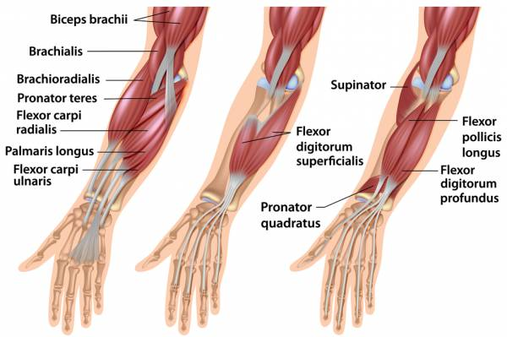

Slide 17
Factors influencing the EMG signal
The quality of the detected sEMG signal determines the usefulness of the information extracted from the sEMG signal.
It is of high importance to maximise the quality of the acquired signal.
The quality of the acquired signal depends on:
Sensor location (upon the middle of muscle belly)
Tissue characteristics
Cross-talk from other muscles
Noise contamination
Notes:
The human body is a good electrical conductor, but unfortunately the electrical conductivity varies with tissue type, thickness (Fig. 14), physiological changes and temperature

Slide 18
EMG signal processing
Frequency Domain
FFT Analysis
Frequency spectrum
Mean frequency
Median frequency
Time Domain
Rectification
Smoothing
Filtering
Amplitude Normalization
…
Time-Frequency Analysis:
Short-time Fourier Transform
Wavelet Transform

Slide 19
Time Domain Vs Frequency
Fourier Transformations
a signal can be considered as a summation of sine waves with different frequency
The FFT algorithm can be described as a decomposition of the EMG signal to its underlying sinus contents

Slide 20
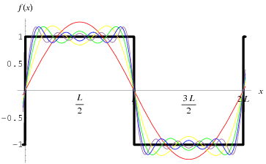
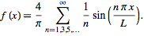

Slide 21
Time Domain: Rectification
Only positive values are analysed
Half-wave rectification
all negative data is discarded
positive data is kept.
Full-wave rectification
the absolute value of each data point is used
Full-wave is preferred

Slide 22
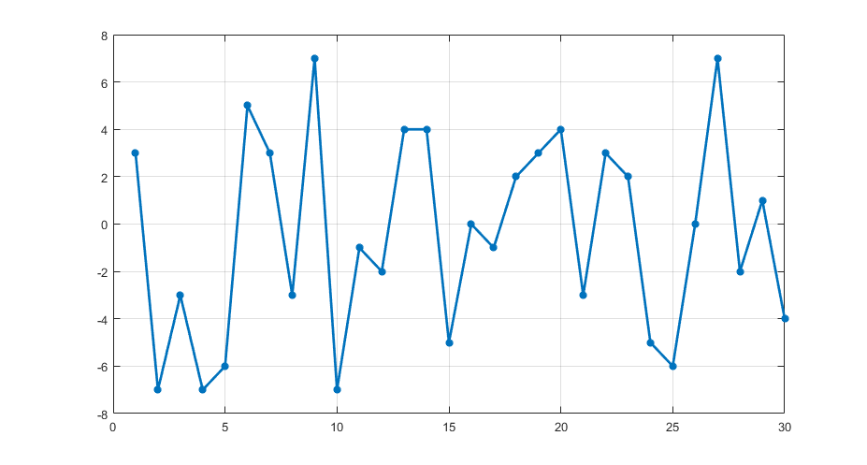
Example

Slide 23
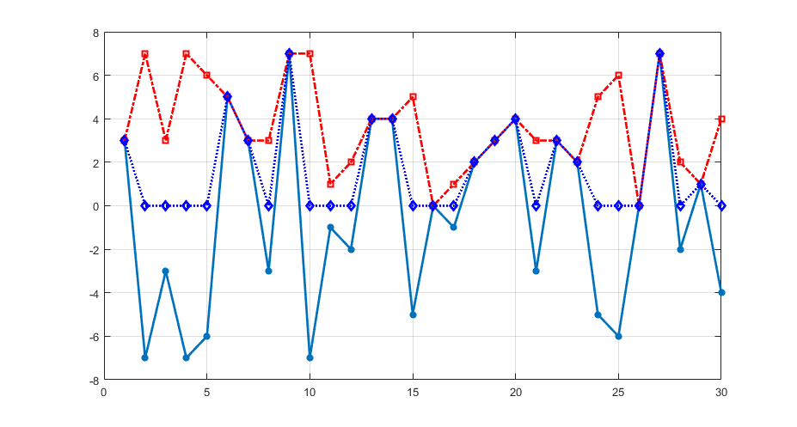
Example

Slide 24
Smoothing
Outline the mean trend of signal development
cutting away steep amplitude spikes
Receiving a amplitude envelop
Moving average
Root mean square
Notes:
Moving Window

Slide 25
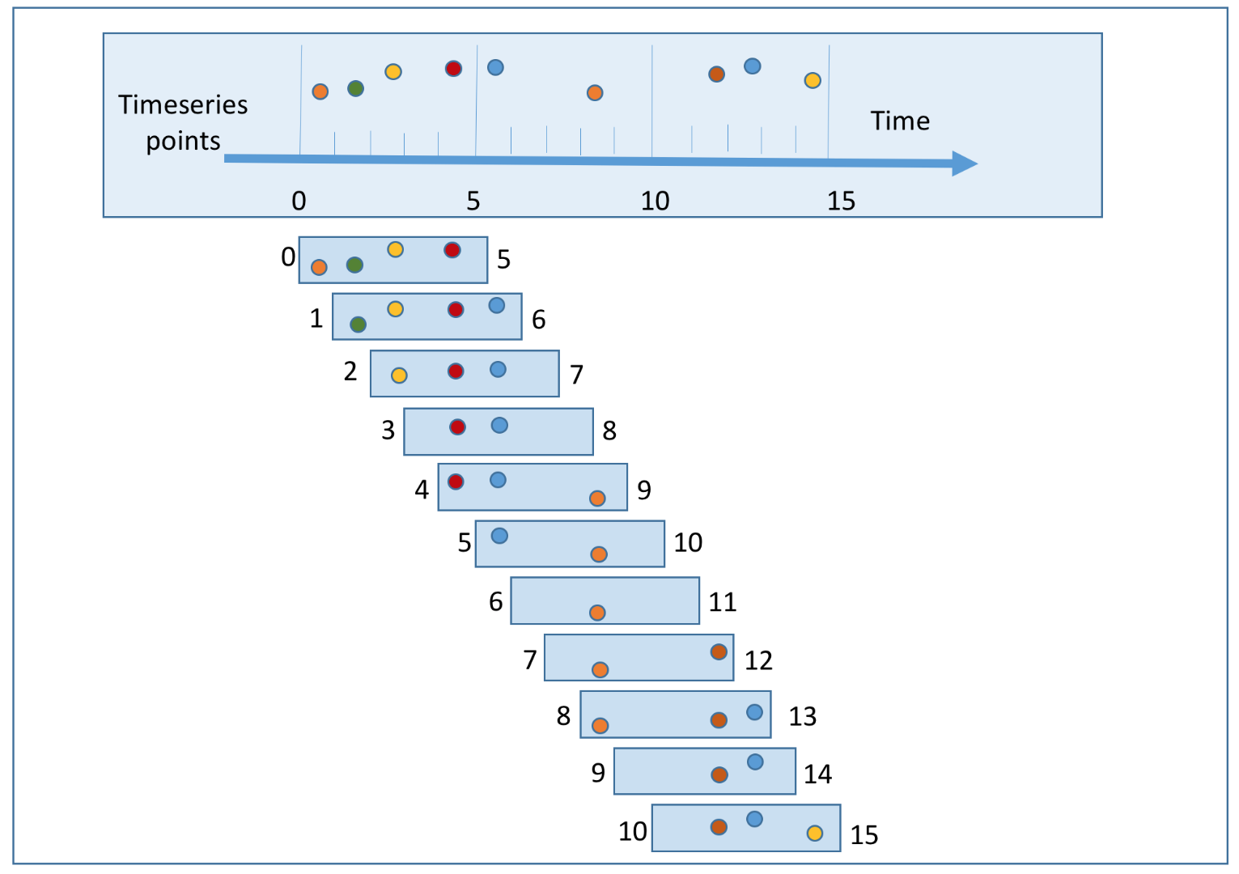
Moving Window

Slide 26
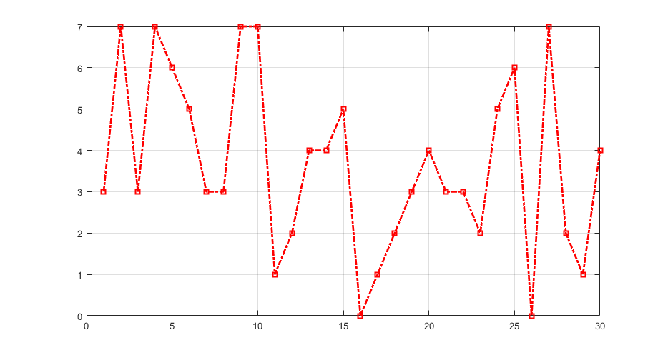
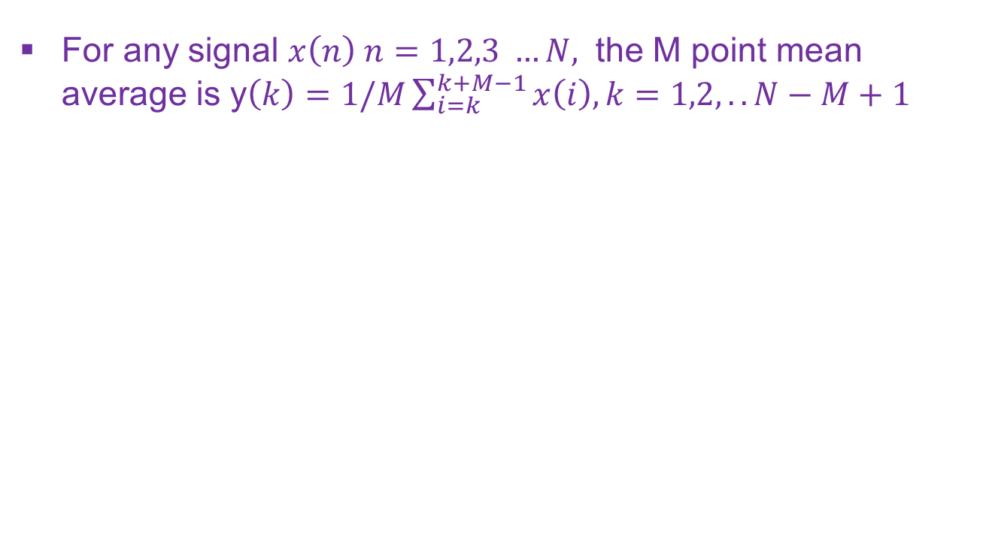
Example
For any signal $x\left(n\right) n=1,2,3 …N,$ the M point mean average is y$\left(k\right)=1/M\sum_{i=k}^{k+M−1}{x\left(i\right), k=1,2,..N−M+1}$

Slide 27
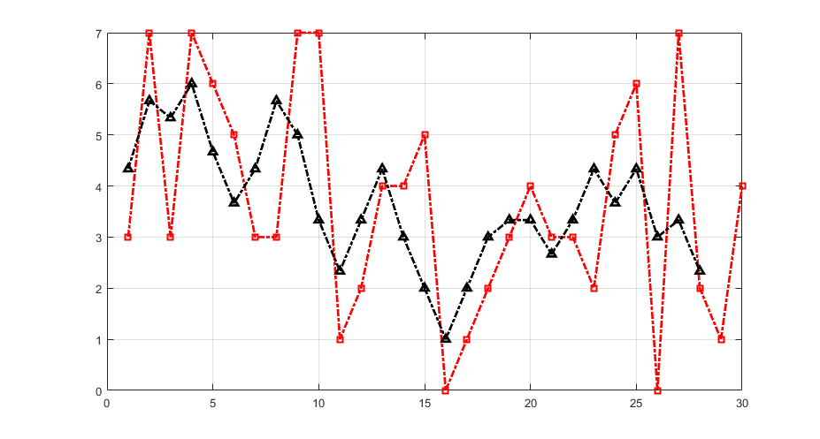
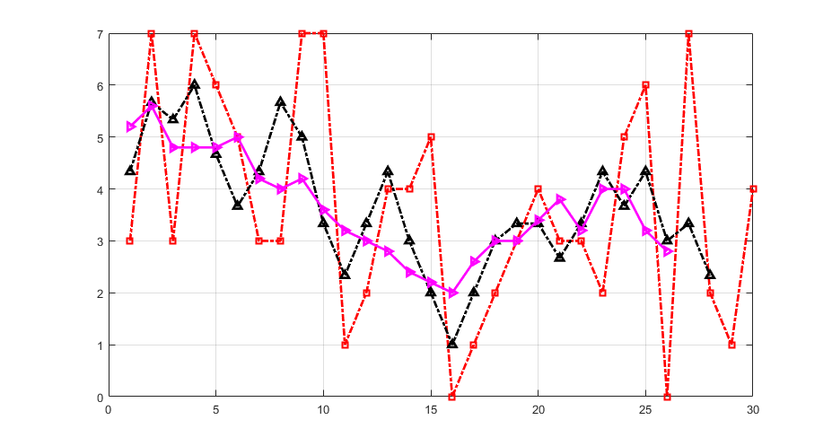

Slide 29
Why rectification and moving average???
A healthy well organized muscle in regular conditions turns off if it is not needed anymore.
If it still stays on, it is an indicator for
active muscle spasm,
reflex induced (e.g. pain) hypertonus
joint instability
behavioural disuse (stress, bad muscle coordination).
Notes:
The flexion-relaxation phenomenon. When
slowly bending forward from an upright position, the
back muscles (ch.1 multifidii) and hip extensors (ch. 2
gluteus maximus) turn off at the most flexed position
(dashed vertical line and video picture). The limb
momentum is held by passive structures like ligaments.
When slowly extending back, both muscles
start firing again. Other synergists (ch. 3 hamstrings)
are active all the time. Low back pain patients can lack
this innervation silence due to dysfunction or pain.

Slide 30
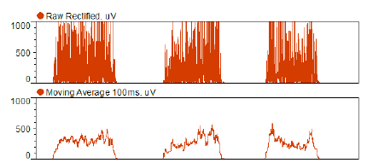

Slide 31
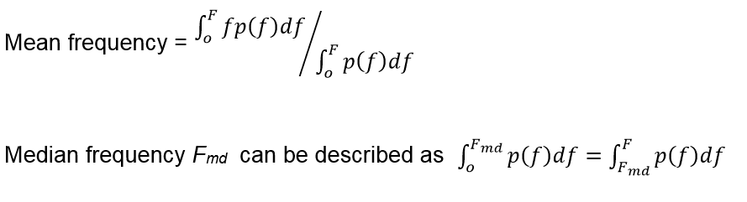
Power Spectrum

Slide 32
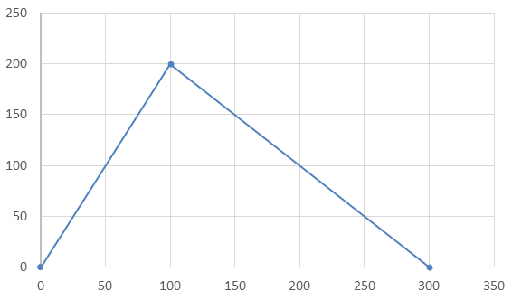
Example
Power
Hz

Slide 33
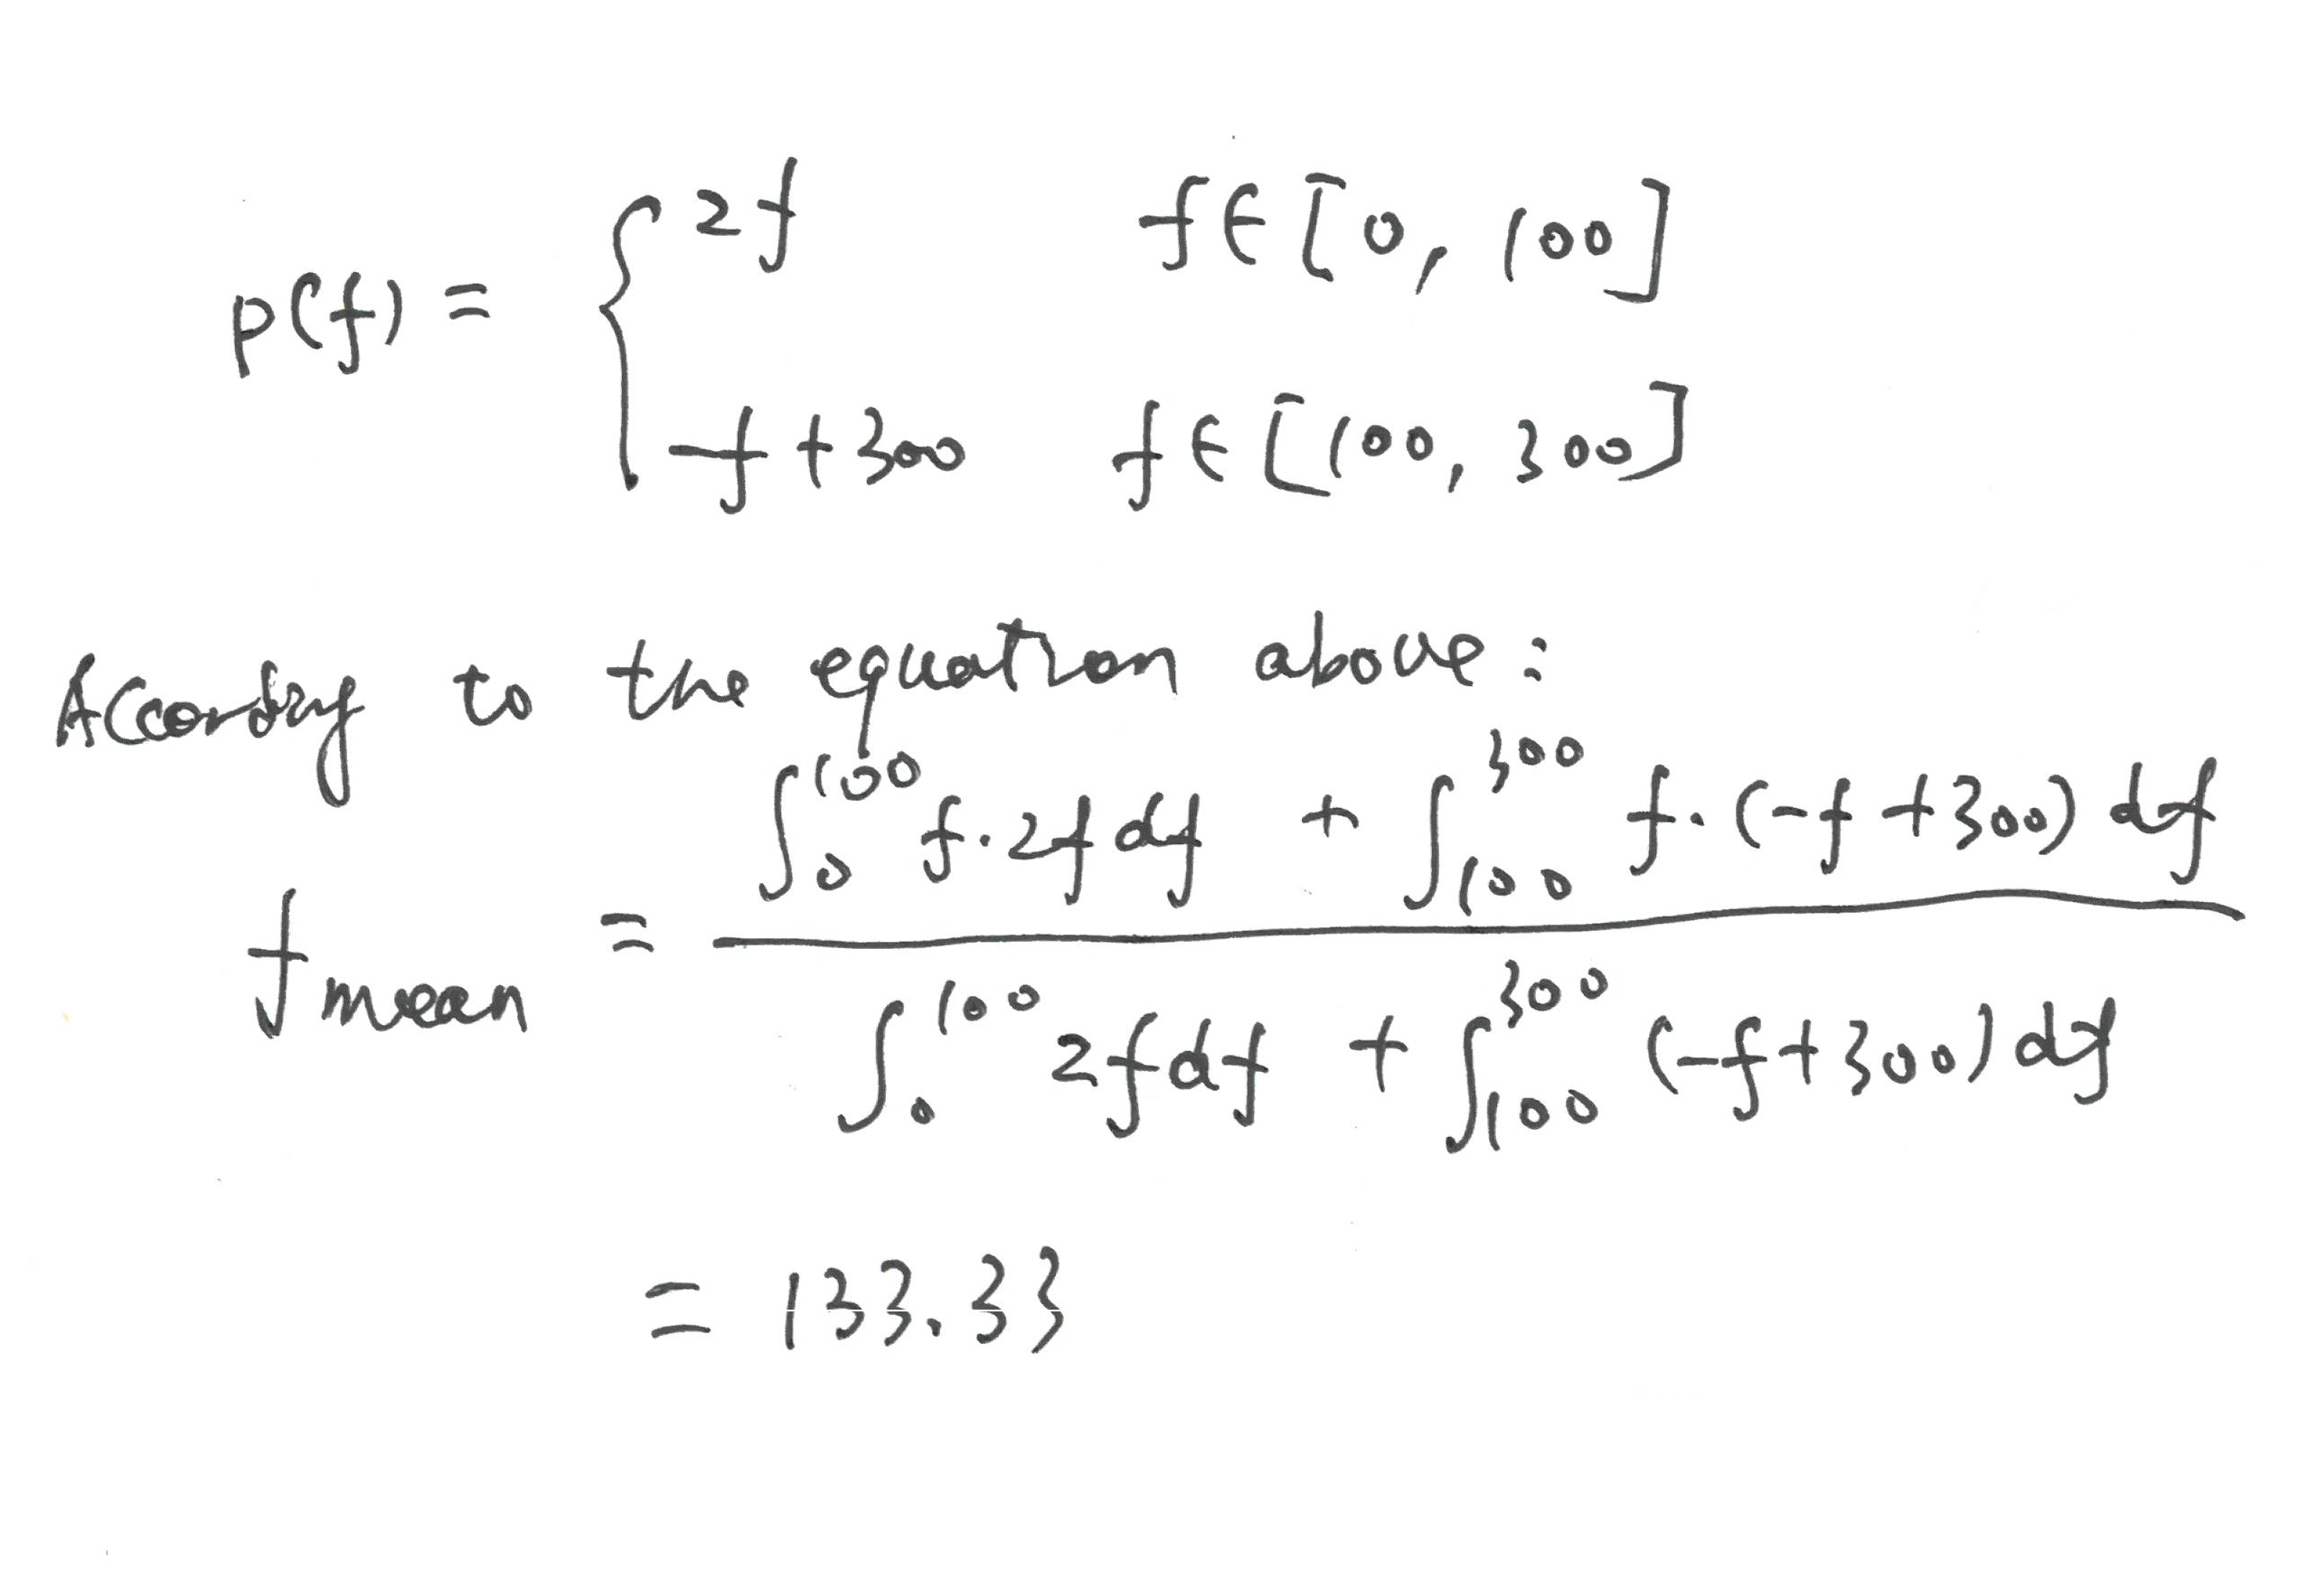
Solution

Slide 34
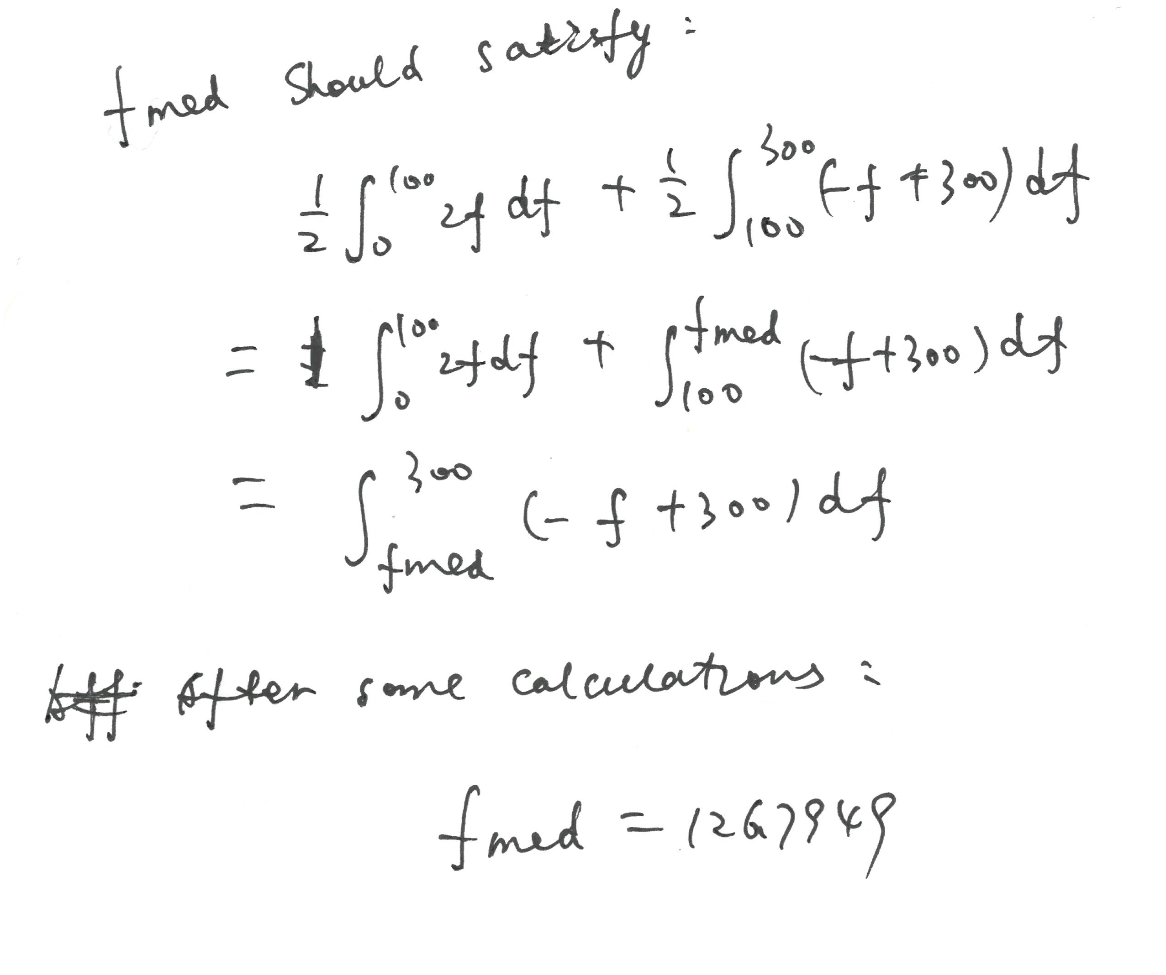
Solution

Slide 35
Fatigue analysis
It can be used to identify weak muscles. The most famous application of frequency shifts is in the analysis of low back pain patient
it can be used to prove the efficiency of strength training exercises
Training induced short term fatigue is the preliminary condition for muscle growth
Notes:
Schematic illustration of the frequency shift towards lower
frequencies in sustained contractions and calculation of the muscle
fatigue index.
Typical test arrangement and findings for static back
endurance tests: Median (A), Mean Frequency (B),

Slide 36
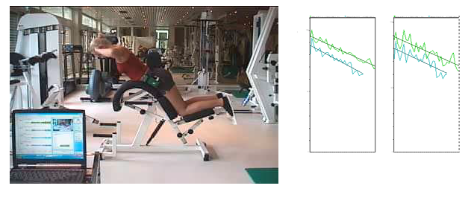

Slide 37
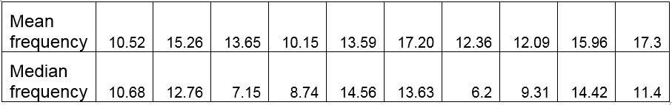
Example (previous example paper)
John is doing some push up and the table below is the median frequency and corresponding mean frequency of his Biceps Brachii muscle during the exercises. Please identify at which five columns are most likely the fatigue happens and why?

Slide 38
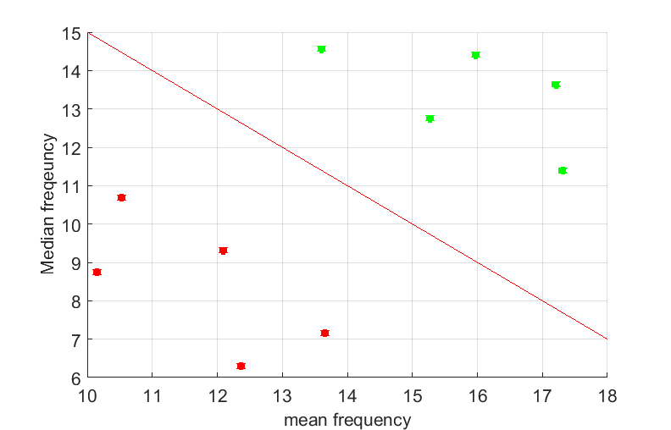

Slide 39
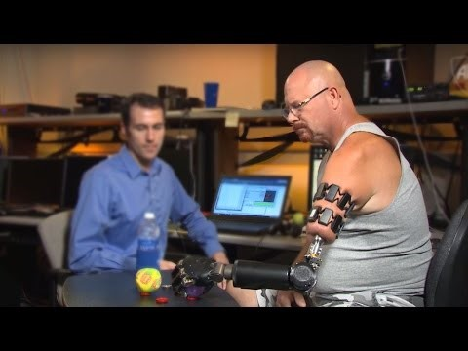
How to use EMG to control prosthetic arm

Slide 40
More complex EMG signal processing
AI or data driven based
Neuromuscular-skeletal model based

Slide 41
AI based
EMG Signal
Time Domain features
Frequency Domain features
Training
Prosthetic device
Controller
AI

Slide 42
AI based
EMG Signal
Time Domain features
Frequency Domain features
Deep learning
Training
Prosthetic device
Controller
AI

Slide 43
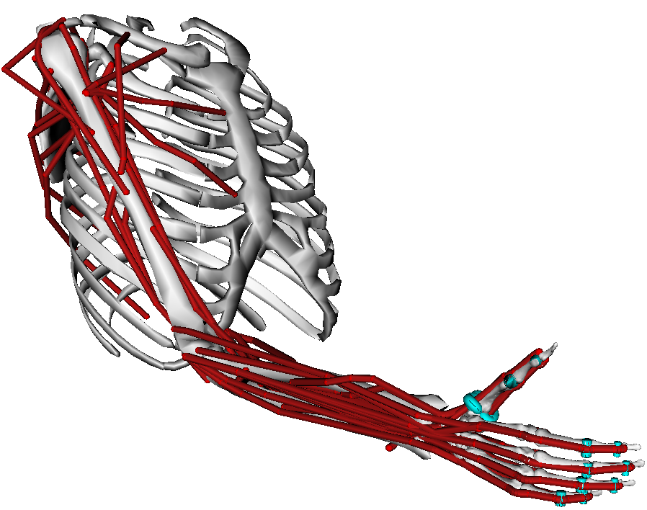
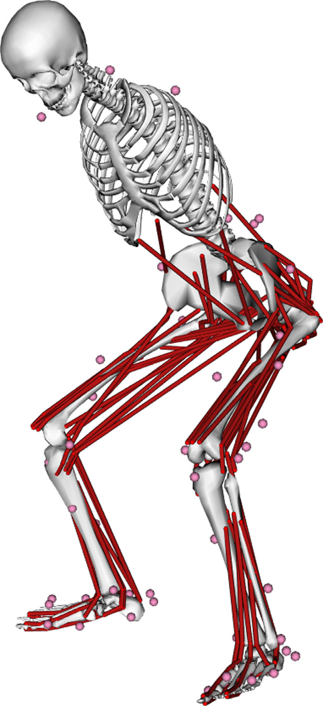
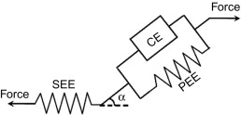
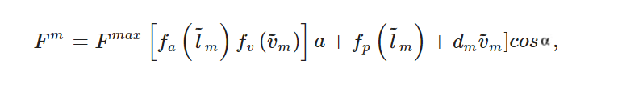
Model-based

Slide 44
